Slide 1

Measurement of Inflation & price Indices in India

Slide 2
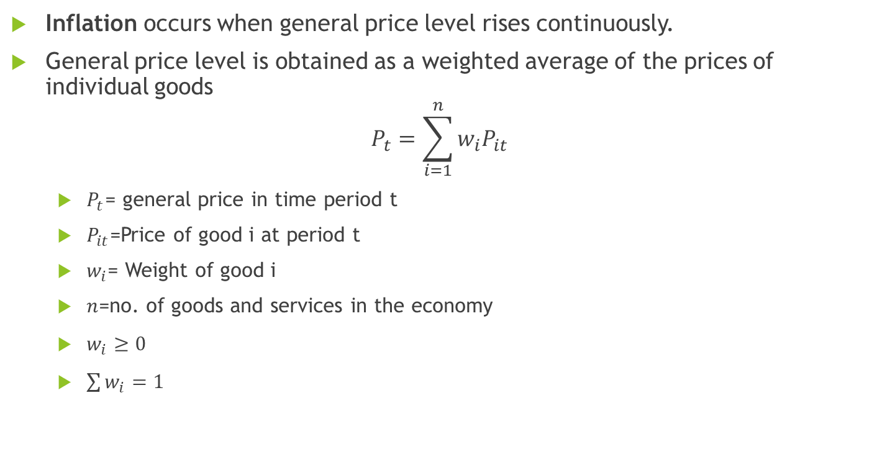
Measuring Inflation
Inflation occurs when general price level rises continuously.
General price level is obtained as a weighted average of the prices of individual goods
$$P_{t}=\sum_{i=1}^{n}{w_{i}P_{it}}$$
$P_{t}$= general price in time period t
$P_{it}$=Price of good i at period t
$w_{i}$= Weight of good i
$n$=no. of goods and services in the economy
$w_{i}≥0$
$\sum{w_{i}=1}$

Slide 3
General Price level: An Example
Goods | Price in the year 2011 (Rs) | Weight
Wheat | 30/kg | 0.5
Cloth | 400/piece | 0.4
Tractor (on rent) | 2000/month | 0.1

Slide 4
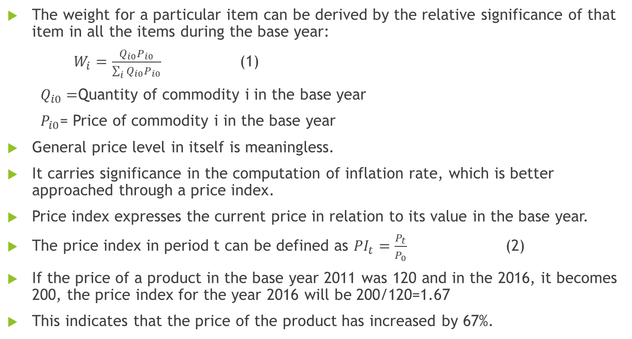
Cont….
The weight for a particular item can be derived by the relative significance of that item in all the items during the base year:
$W_{i}=\frac{Q_{i0}P_{i0}}{\sum_{i}{Q_{i0}P_{i0}}}$ (1)
$Q_{i0}=$Quantity of commodity i in the base year
$P_{i0}$= Price of commodity i in the base year
General price level in itself is meaningless.
It carries significance in the computation of inflation rate, which is better approached through a price index.
Price index expresses the current price in relation to its value in the base year.
The price index in period t can be defined as ${PI}_{t}=\frac{P_{t}}{P_{0}}$ (2)
If the price of a product in the base year 2011 was 120 and in the 2016, it becomes 200, the price index for the year 2016 will be 200/120=1.67
This indicates that the price of the product has increased by 67%.

Slide 5
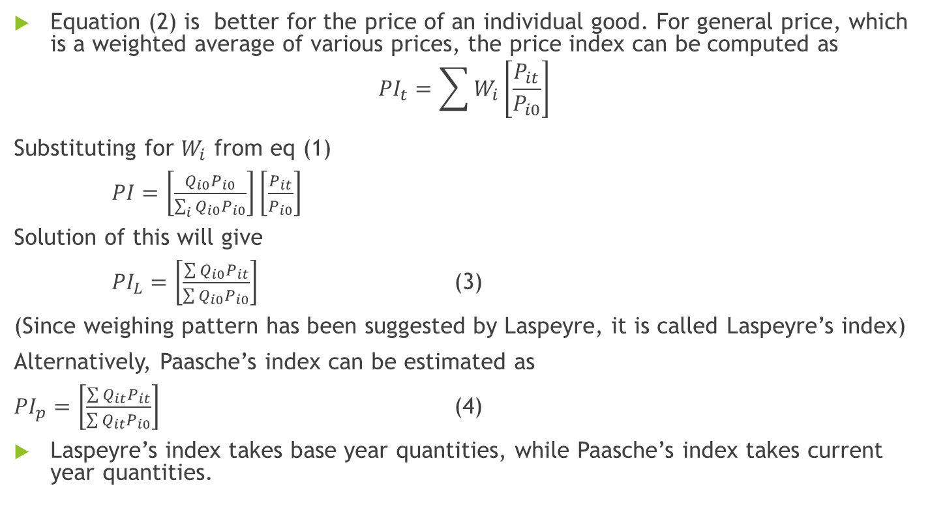
Cont….
Equation (2) is better for the price of an individual good. For general price, which is a weighted average of various prices, the price index can be computed as
$${PI}_{t}=\sum{W_{i}\left[\frac{P_{it}}{P_{i0}}\right]}$$
Substituting for $W_{i}$ from eq (1)
$PI=\left[\frac{Q_{i0}P_{i0}}{\sum_{i}{Q_{i0}P_{i0}}}\right]\left[\frac{P_{it}}{P_{i0}}\right]$
Solution of this will give
${PI}_{L}=\left[\frac{\sum{Q_{i0}P_{it}}}{\sum{Q_{i0}P_{i0}}}\right]$ (3)
(Since weighing pattern has been suggested by Laspeyre, it is called Laspeyre’s index)
Alternatively, Paasche’s index can be estimated as
${PI}_{p}=\left[\frac{\sum{Q_{it}P_{it}}}{\sum{Q_{it}P_{i0}}}\right]$ (4)
Laspeyre’s index takes base year quantities, while Paasche’s index takes current year quantities.

Slide 6
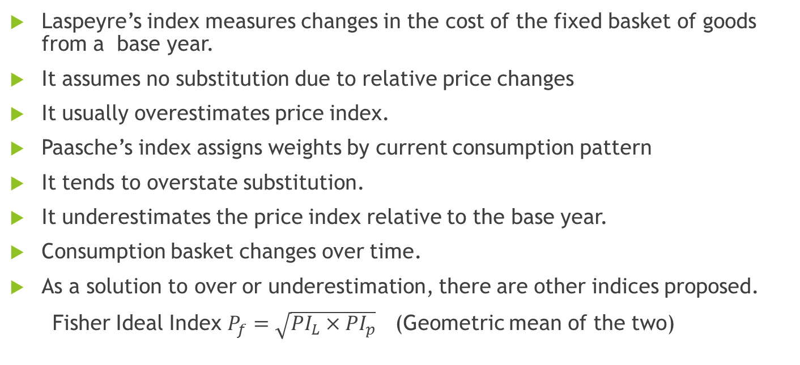
Comparison between two indices
Laspeyre’s index measures changes in the cost of the fixed basket of goods from a base year.
It assumes no substitution due to relative price changes
It usually overestimates price index.
Paasche’s index assigns weights by current consumption pattern
It tends to overstate substitution.
It underestimates the price index relative to the base year.
Consumption basket changes over time.
As a solution to over or underestimation, there are other indices proposed.
Fisher Ideal Index $P_{f}=\sqrt{{PI}_{L}×{PI}_{p}}$ (Geometric mean of the two)

Slide 7
Selection of a Base Year: The Key Criteria
A Normal year (no abnormalities in trade, production, price level and price variations)
A year in which reliable production, price and other required data area available
A year as latest as possible and comparable with the other data series

Slide 8
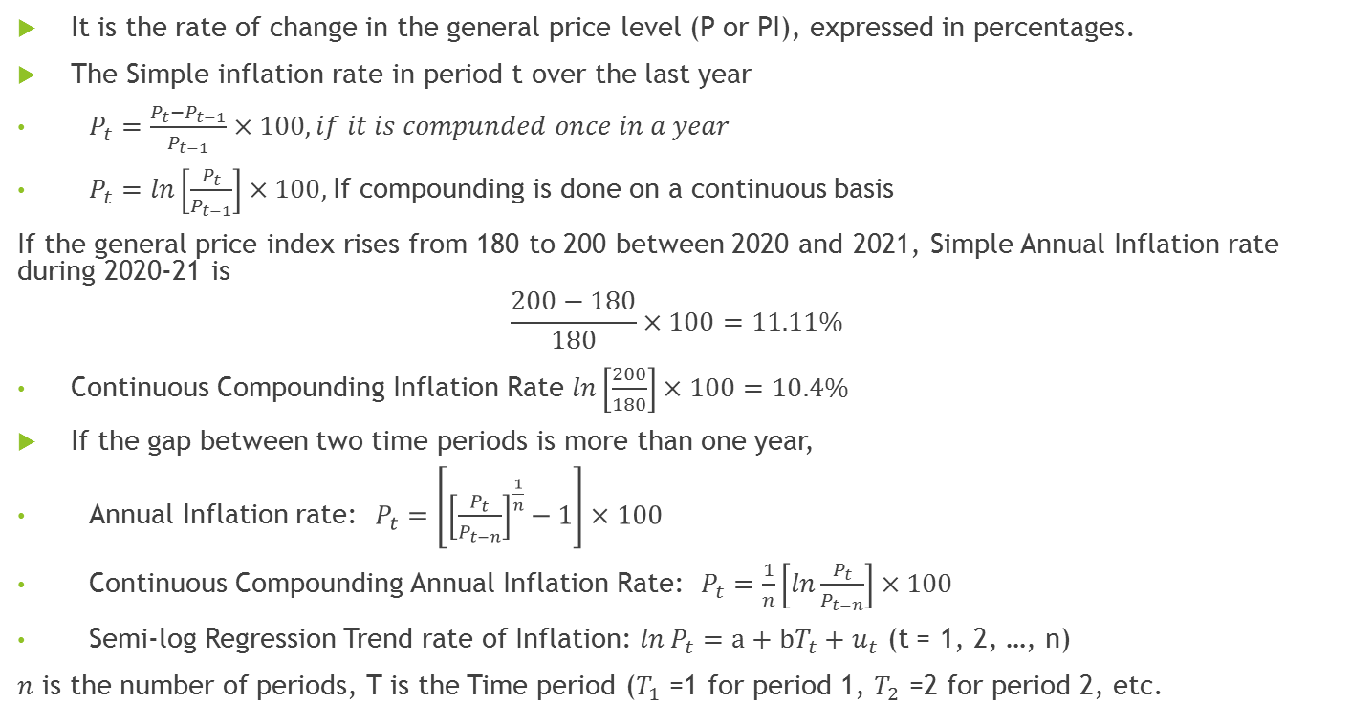
Estimation of Inflation Rate
It is the rate of change in the general price level (P or PI), expressed in percentages.
The Simple inflation rate in period t over the last year
$P_{t}=\frac{P_{t}−P_{t−1}}{P_{t−1}}×100, if it is compunded once in a year$
$P_{t}=ln\left[\frac{P_{t}}{P_{t−1}}\right]×100,$If compounding is done on a continuous basis
If the general price index rises from 180 to 200 between 2020 and 2021, Simple Annual Inflation rate during 2020-21 is
$$\frac{200−180}{180}×100=11.11\%$$
Continuous Compounding Inflation Rate $ln\left[\frac{200}{180}\right]×100=10.4\%$
If the gap between two time periods is more than one year,
Annual Inflation rate: $P_{t}=\left[{\left[\frac{P_{t}}{P_{t−n}}\right]}^{\frac{1}{n}}−1\right]×100$
Continuous Compounding Annual Inflation Rate: $P_{t}=\frac{1}{n}\left[ln\frac{P_{t}}{P_{t−n}}\right]×100$
Semi-log Regression Trend rate of Inflation: $ln{ P}_{t}=a+bT_{t}+u_{t}$ (t = 1, 2, …, n)
$n$ is the number of periods, T is the Time period ($T_{1}$ =1 for period 1, $T_{2}$ =2 for period 2, etc.

Slide 9
Wholesale Price Index (WPI)
WPI measures the changes in the prices of goods in the stages before the retail level.
This refers to goods that are sold in bulk and traded between businesses.
Includes prices of raw materials, semi-finished goods, imported tangible goods
Includes also prices of tangible goods if transacted at the wholesale level
Excludes prices of all services- education, health, banking, transport and communication
For agriculture, marketed surplus is in use, not marketable surplus.
Weighted Arithmetic Mean and Laspeyre’s formula are used.
The Office of the Economic Adviser in the Department of Industrial Policy and Promotion, Ministry of Commerce & Industry is responsible for compiling WPI and releasing it.

Slide 10
Measurement of WPI: An Example (Base 2011-12=100)

Slide 11
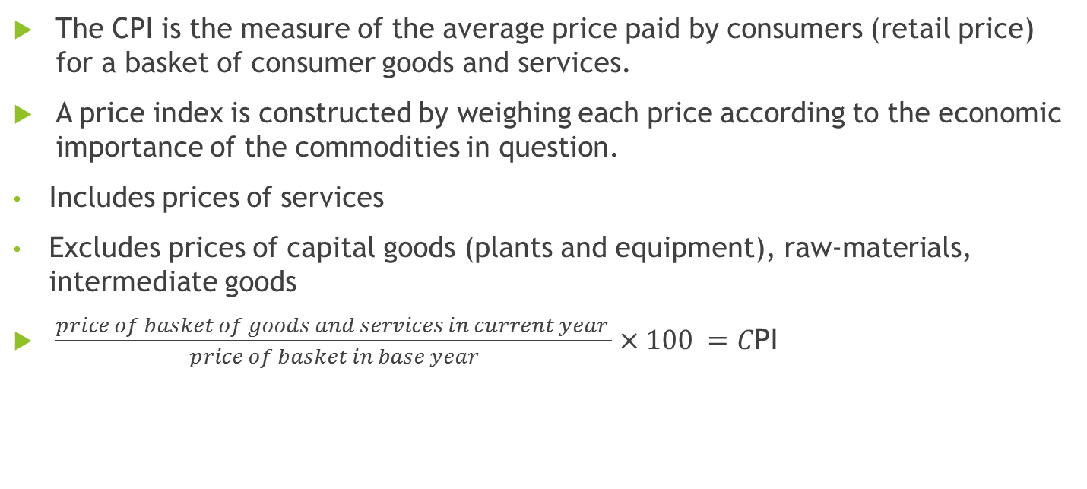
Consumer Price Index (CPI)
The CPI is the measure of the average price paid by consumers (retail price) for a basket of consumer goods and services.
A price index is constructed by weighing each price according to the economic importance of the commodities in question.
Includes prices of services
Excludes prices of capital goods (plants and equipment), raw-materials, intermediate goods
$\frac{price of basket of goods and services in current year }{price of basket in base year}×100 =C$PI

Slide 12
Types of CPI
CPI for Industrial Workers (CPI-IW): Labour Bureau, Ministry of Labour (Base Year 2016)
CPI for Urban Non-Manual Employees (CPI-UNME) (50% or more incomes from non-manual work outside agriculture): CSO (Discontinued since 2011)
CPI for Agricultural labour (CPI-AL): Labour Bureau, Ministry of Labour
CPI for Rural Labour: Labour Bureau, Ministry of Labour
CPI (Urban/Rural): Base year 2012 (Ministry of Statistics and Programme Implementation)
The Price data are collected from selected 1114 urban Markets and 1181 villages covering all States/UTs through personal visits by field staff of Field Operations Division of NSO, MoSPI on a weekly roster. During the month of January 2022, NSO collected prices from 99.7% villages and 98.2% urban Markets while the Market-wise prices reported therein were 89.3% for rural and 93.3% for urban.
These are first done at the State level and at select centres.
Aggregation is done as the weighted arithmetic mean of the of the respective indices with weights taken as proportional to the aggregate expenditure of the State/Centre in all India figure.
Laspeyre’s index is used.
For deciding weights of individual goods/services, surveys are conducted across the country.

Slide 13
CPI-IW: Group Weights

Slide 14
Sr. No. | Group / Sub group | Weight for
 |  | CPI-IW 2001=100 | CPI-AL 1986-87=100 | CPI-RL 1986-87=100
I | Food Group
 | Cereals and Products | 13.48 | 40.94 | 38.15
 | Pulse and Products | 2.91 | 3.39 | 3.40
 | Oil and Fats | 3.23 | 3.83 | 3.79
 | Meat, Fish and Eggs | 3.97 | 3.10 | 3.31
 | Milk and Product | 7.31 | 3.74 | 3.94
 | Condiments and Spices | 2.57 | 4.12 | 3.92
 | Vegetable and Fruits | 6.05 | 5.06 | 5.05
 | Other food | 6.68 | 4.97 | 5.21
 | Total Food Group | 46.20 | 69.15 | 66.77
 | Pan, Supari, tobacco and intoxicants | 2.27 | 3.79 | 3.70
II | Fuel and Light | 6.43 | 8.35 | 7.90
III | Housing Group | 15.27 | - | -
IV | Clothing, Bedding and Footwear | 6.57 | 6.98 | 9.76
V | Miscellaneous
 | Medical Care | 4.56 | 4.38 | 4.23
 | Education, Recreation and Amusement | 6.18 | 0.94 | 0.99
 | Transport and Communication | 4.87 | 1.67 | 1.80
 | Personal Care and Effects | 4.22 | 2.04 | 2.28
 | Others | 3.43 | 2.70 | 2.57
 | Total Miscellaneous Group | 23.26 | 11.73 | 11.87
 | Total | 100 | 100 | 100

Slide 15
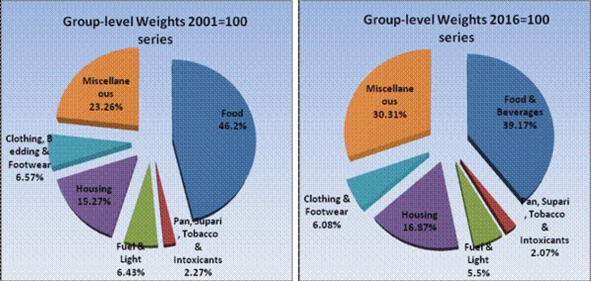

Slide 16
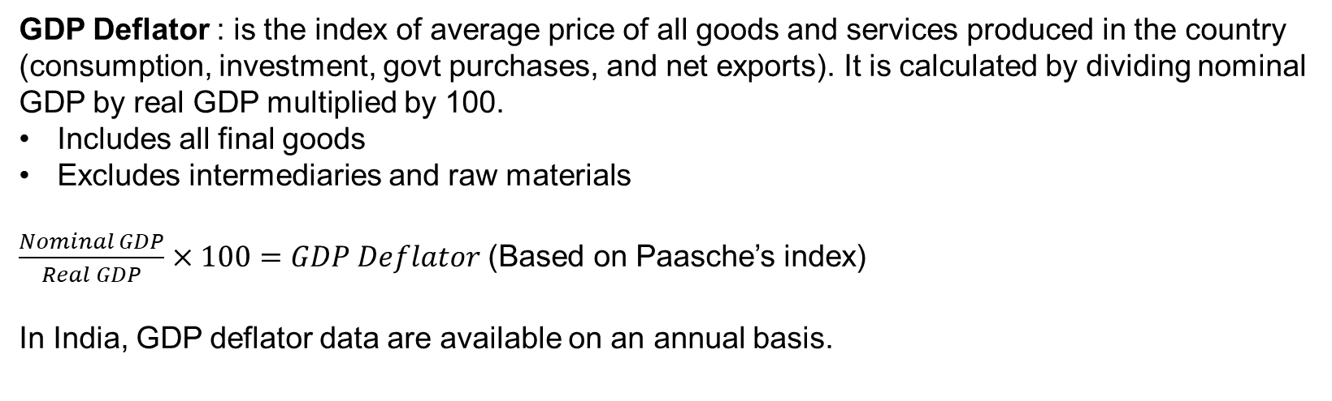
GDP Deflator : is the index of average price of all goods and services produced in the country (consumption, investment, govt purchases, and net exports). It is calculated by dividing nominal GDP by real GDP multiplied by 100.
Includes all final goods
Excludes intermediaries and raw materials
$\frac{Nominal GDP}{Real GDP}×100=GDP Deflator$ (Based on Paasche’s index)
In India, GDP deflator data are available on an annual basis.

Slide 17
GDP Deflator: An Example
Year | Nominal GDP | Real GDP | GDP Deflator
2012 | 10x10,000+120x400+780x50=187000 | 10x10000+120x400+780x50=187000 | 1
2020 | 15x12000+200x500+1000x75=355000 | 10x12000+120x500+780x75=238500 | 1.489

Slide 18
Inflation can be classified into three categories according to its severity: low inflation, galloping inflation and hyperinflation.
Low inflation: Low inflation is characterized by prices that rise slowly and predictably. When prices are relatively stable, people trust money because it retains its value from month to month and year to year.
Galloping inflation: Also called very high inflation, when inflation rate becomes double-digit or triple-digit percent per year. Galloping inflation is relatively common particularly in countries suffering from weak governments, war or revolution.
Hyperinflation: Hyperinflation is more dangerous than galloping inflation. In this situation, the real money stock falls drastically and relative prices become highly unstable.

